Slide 1
The Power Of Believing That You Can Improve
Ayyan Ali (22k-5194)
Amal A.R (22k-4822)
M. Abdullah (22k-5156)
Ali Nazir (22k-5164)
Mustafa Masood (22k-4818)
Laiba Fatima (22k-5195)
Sameer (22k-5193)

Slide 2
Table of Contents
01
04
02
05
03
06
07
Introduction
Impact of Praise & Feedback
Video Summary
Evidence from Research
Fixed vs Growth Mindset
Questions from Speaker
Conclusion

Slide 3
01
Introduction

Slide 4
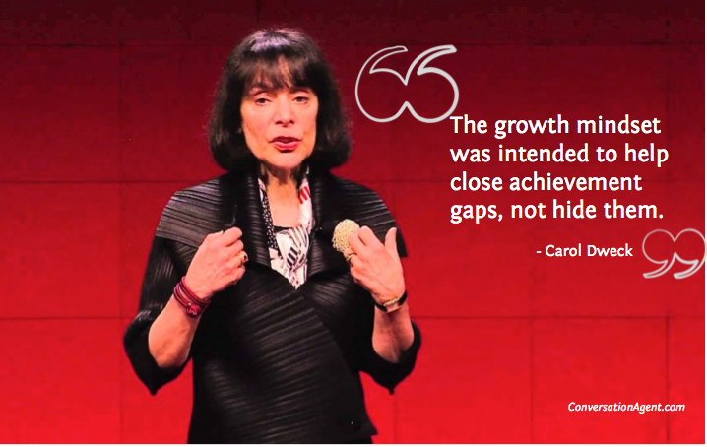
Introduction
"The Power of Believing You Can Improve," is based on the insights shared by psychologist Carol Dweck in her TED Talk. It’s all about the transformative concept of mindset and its impact on learning and achievement.

Slide 5
02
Video Summary

Slide 6
Summary
Carol Dweck explores the concept of mindset and its implications.
Distinguishes between two mindsets: the fixed mindset, and growth mindset.
Dweck emphasizes the importance of praising effort over intelligence
Shares examples of how adopting a growth mindset can lead to greater success and resilience.

Slide 7
03
Fixed vs. Growth Mindset

Slide 8
Fixed Mindset
Growth Mindset
Abilities are seen as static and unchangeable.
Individuals may avoid challenges due to fear of failure.
Effort is often perceived as futile.
Abilities can be developed through dedication and hard work.
Individuals embrace challenges as opportunities for growth.
Effort is valued as the path to mastery.

Slide 9
04
Impact of Praise and Feedback

Slide 10
Praise for Intelligence
Praise for Effort
Can foster a fear of failure and a reluctance to take on challenges.
Leads individuals to believe that success should come effortlessly.
May result in a fixed mindset and a limited view of one's capabilities.
Encourages individuals to embrace challenges and persist in the face of setbacks.
Cultivates a belief in the power of dedication and hard work.
Fosters a growth mindset and a willingness to learn and improve.

Slide 11
05
Evidence from Research

Slide 12
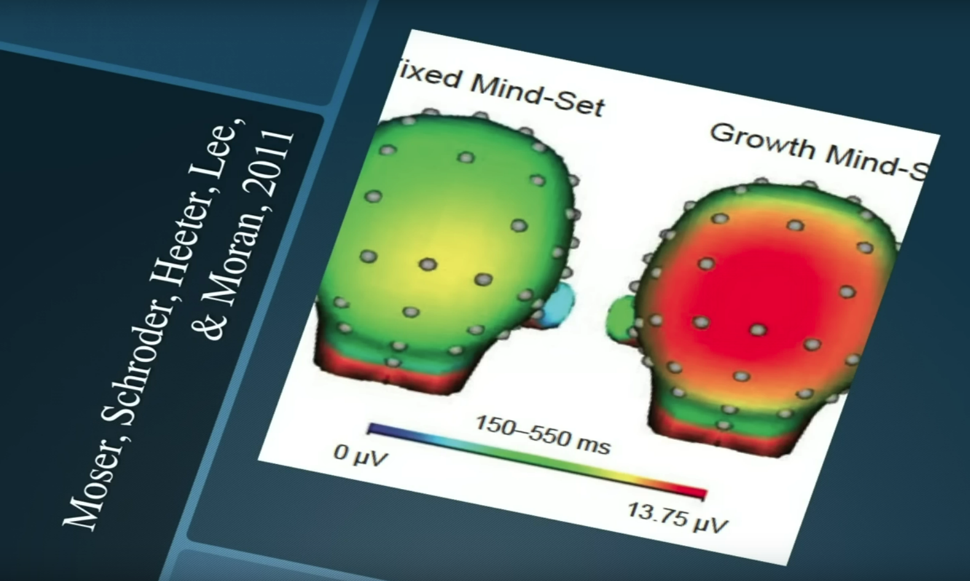
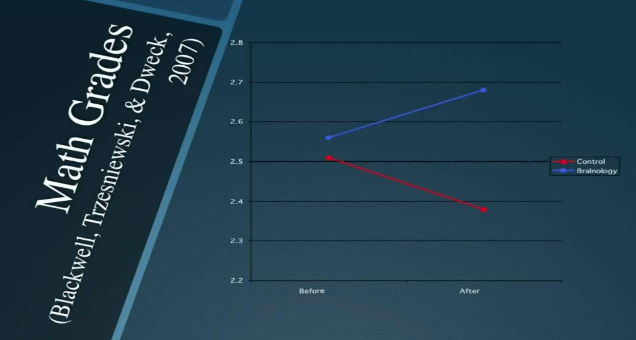
Evidences
Dweck presents evidence from her own research studies and examples from various fields such as education, sports, and business.
She shares studies where students were praised for effort rather than intelligence, and how this simple shift in feedback led to significant improvements in their performance and attitude toward learning.

Slide 13
06
Questions for Speaker

Slide 14
How can individuals effectively transition from a fixed mindset to a growth mindset, especially if they have been conditioned to believe their abilities are static?
How can educators and parents best implement the principles of growth mindset in their interactions with children and students?
Are there any specific strategies or techniques you recommend for cultivating a growth mindset in oneself and others?

Slide 15
07
Conclusion

Slide 16

In conclusion, Carol Dweck's TED Talk sheds light on the transformative power of mindset. By adopting a growth mindset and believing in our capacity to improve through effort and dedication, we open ourselves up to endless possibilities for learning and growth.
References:
Link to Ted Talk

Slide 17
Thank You!

